Slide 1
Karnaugh Maps
CSE260 Digital Logic Design
CSE260 Digital Logic Design

Slide 2
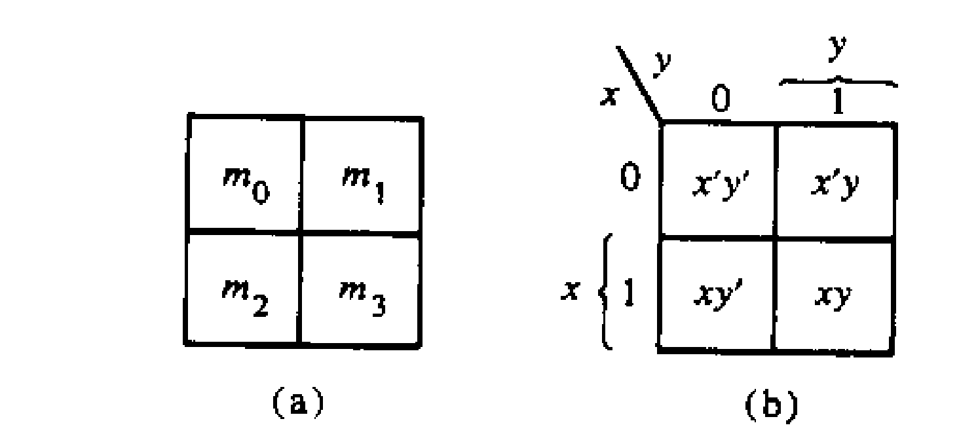
The map method
The map method provides a simple procedure for minimizing Boolean functions.
The map is made up of squares where each square represent a minterm.
We represent each minterm of an equation by ‘1’s
We groups the adjacent ‘1’s in groups of 2, groups of 4 or groups of 8 and so on.
In those grouping try to find the common literal.
The map method is often known as Karnaugh Map or Veitech Diagram. In short we will call it K-map

Slide 3
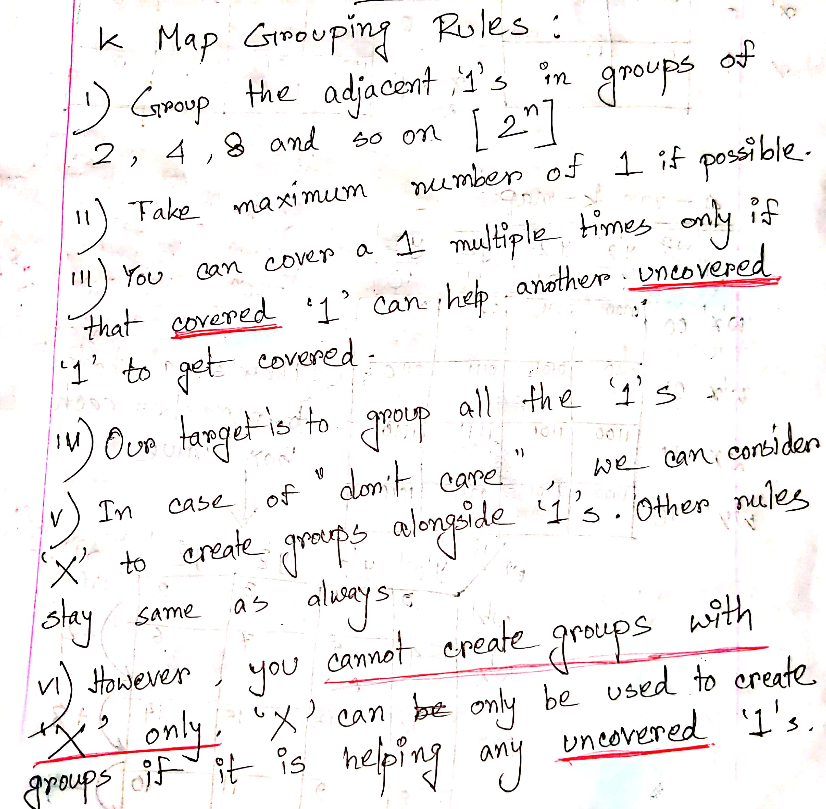

Slide 4
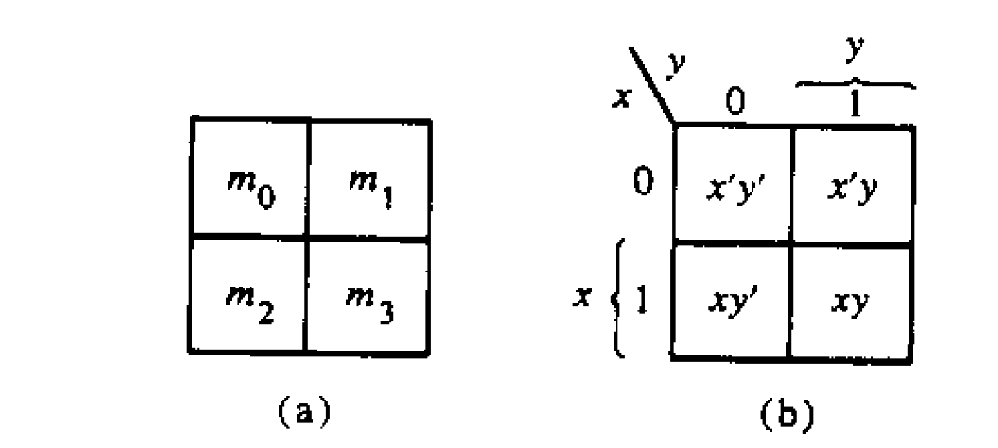
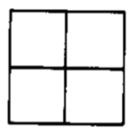
Two variable map
There are 4 minterm of 2 variable; hence the map is four squares, one for each minterm.
Only 1 bit changes
Only 1 bit changes
00
01
10
11

Slide 5
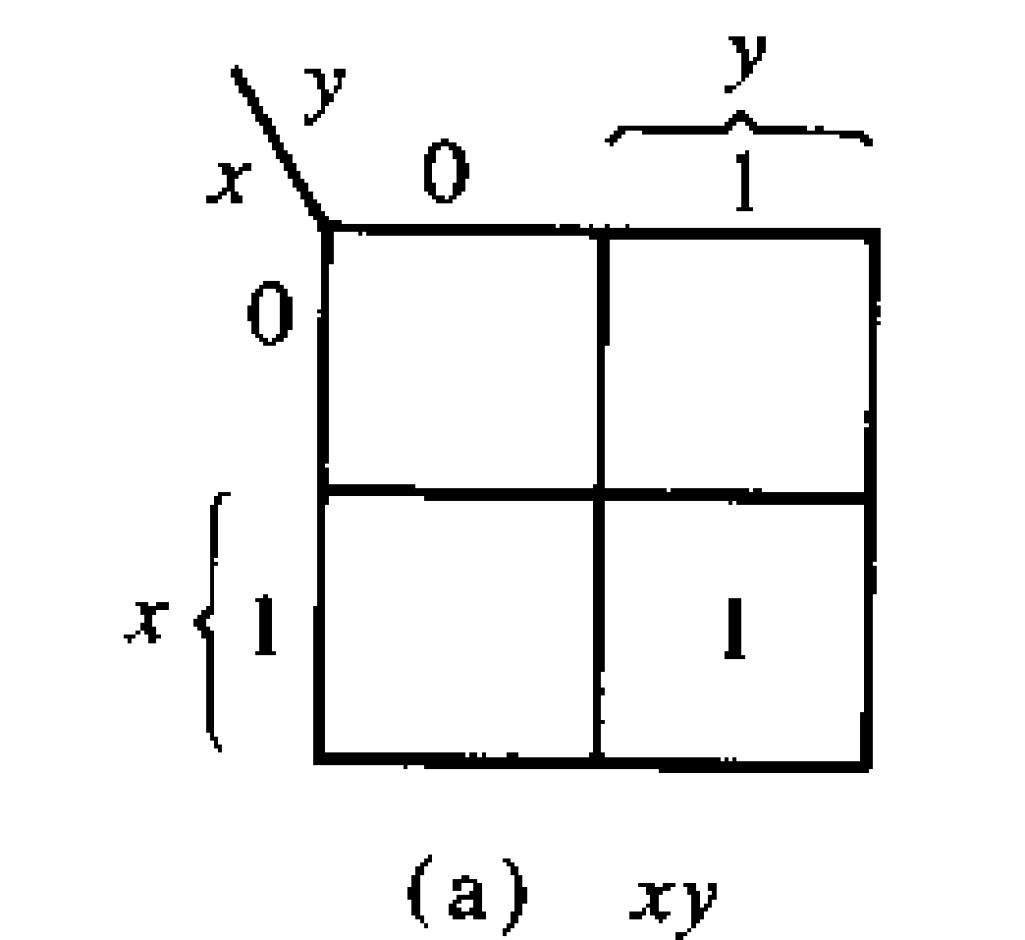
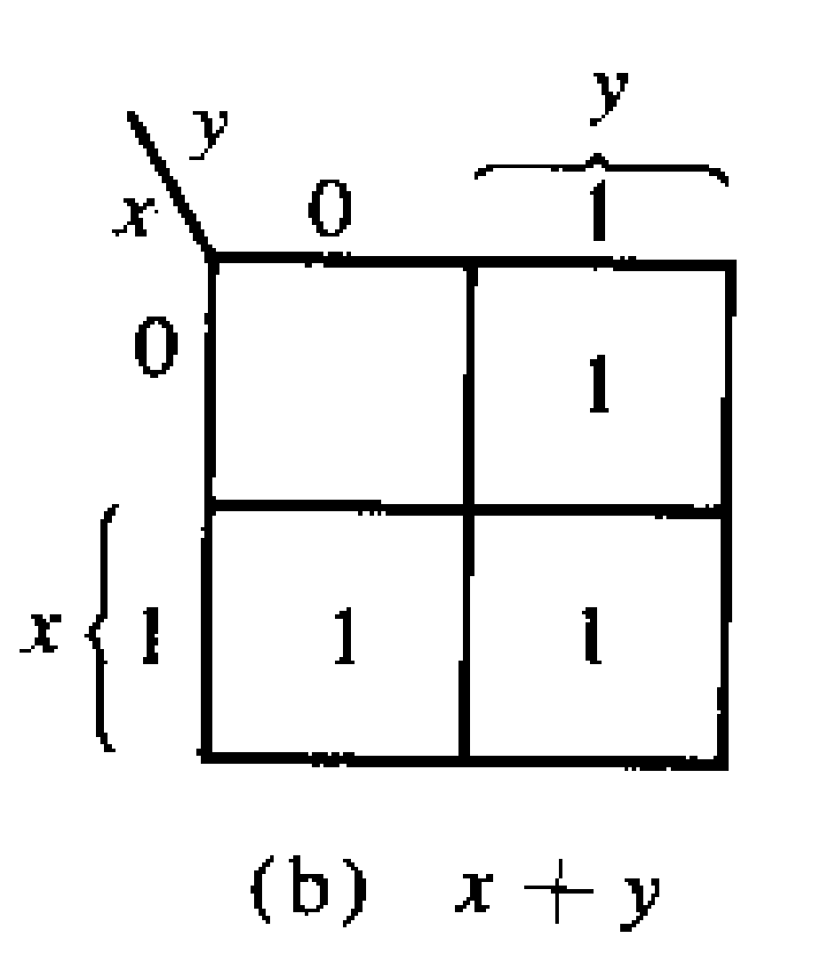
Representing function in K-map
(a) F1=xy;
(b) F2=xy’+xy+x’y
=x(y’+y)+x’y
=x+x’y
=(x+x’)(x+y) =(1)(x+y)
=x+y

Slide 6
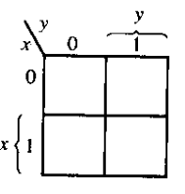
Try it yourself
F=xy’+x’y’+x’y, Simplify the equation using k-map
Solution
F=xy’+x’y’+x’y=x’+y’
1
1
1

Slide 7
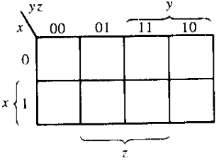
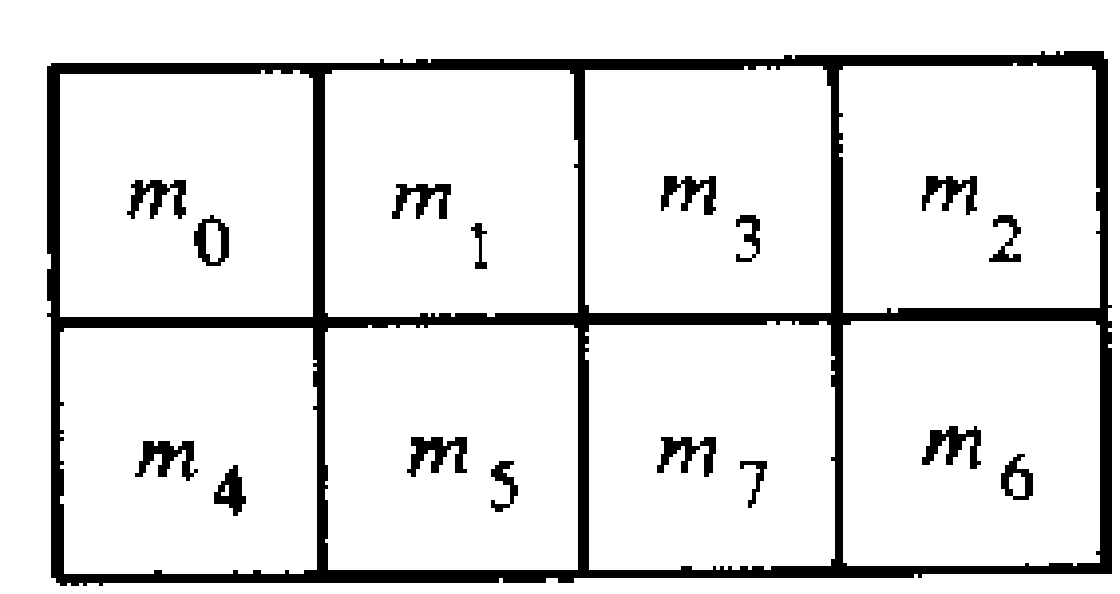
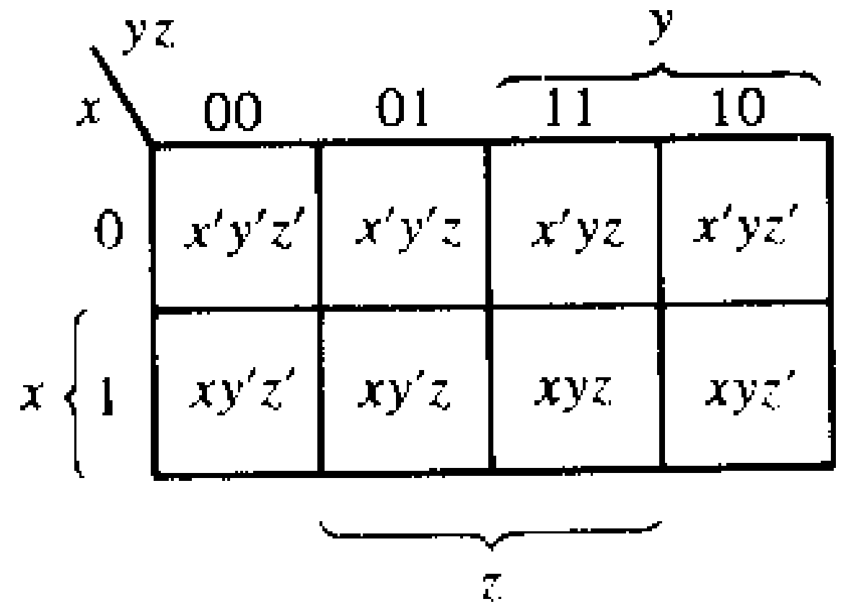
Three variable map
Sequence in 3-variable map is not in binary sequence but in reflected code. In reflected code, at a time only 1 bit changes from 0 to 1 and 1 to 0.
Numbering of minterms follow binary numbers. Example m5 is at 101 i.e. row 1 and column 01.
Note: Any 2 adjacent square differ by 1 variable ( which is primed in one and unprimed in the other )
000
001
011
010
100
101
111
110

Slide 8
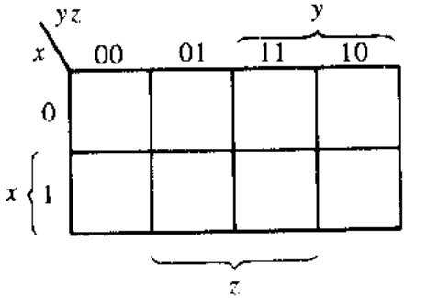
If any 2 adjacent square differ by 1 variable ( which is primed in one and unprimed in the other ) and they are grouped, then any 2 minterms in the adjacent square are ORed, will remove the different term. As a result , we get a single ANDed term of only 2 common literals
F1=∑(5,7)=xy’z+xyz=xz(y’+y)=xz
F2=∑(0,2)=x’y’z’+x’yz'=x’z’(y’+y)=x’z’
1
1
1
1

Slide 9
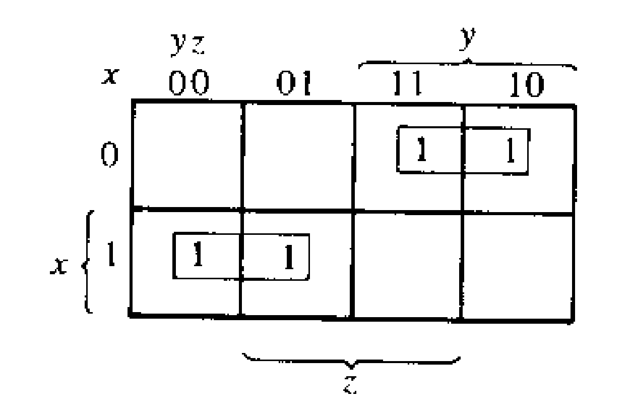
Simplifying functions using k-map
F=∑(2,3,4,5)=x’yz+x’yz’+xy’z’+xy’z (note: in other words, F= (∑(010,011,100,101) so place ‘1’ in those positions and group the adjacent ones)
F=x’y+xy’
Grouping of 1 can be done in groups of
two ‘1’,four ‘1’,eight ‘1’.…2^n ‘1’.
x’y
xy’

Slide 10
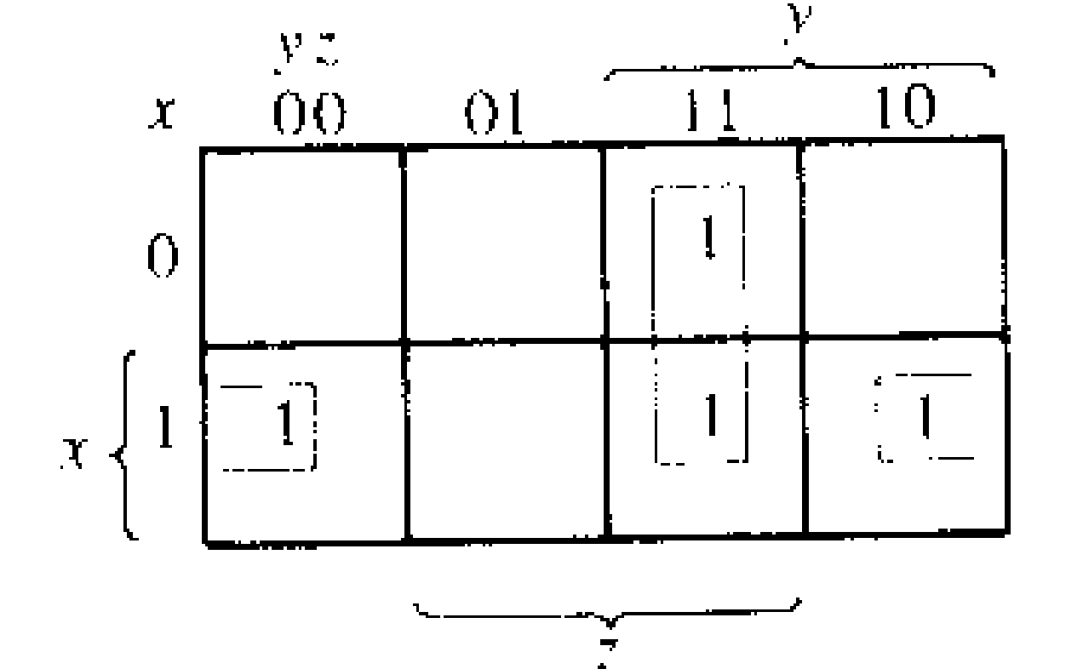
F1=x’yz+xy’z’+xyz+xyz’=xz’+yz
011
100
111
110
yz
Notice even 2 opposite edges of the map are adjacent, thus they can be grouped
xz’

Slide 11
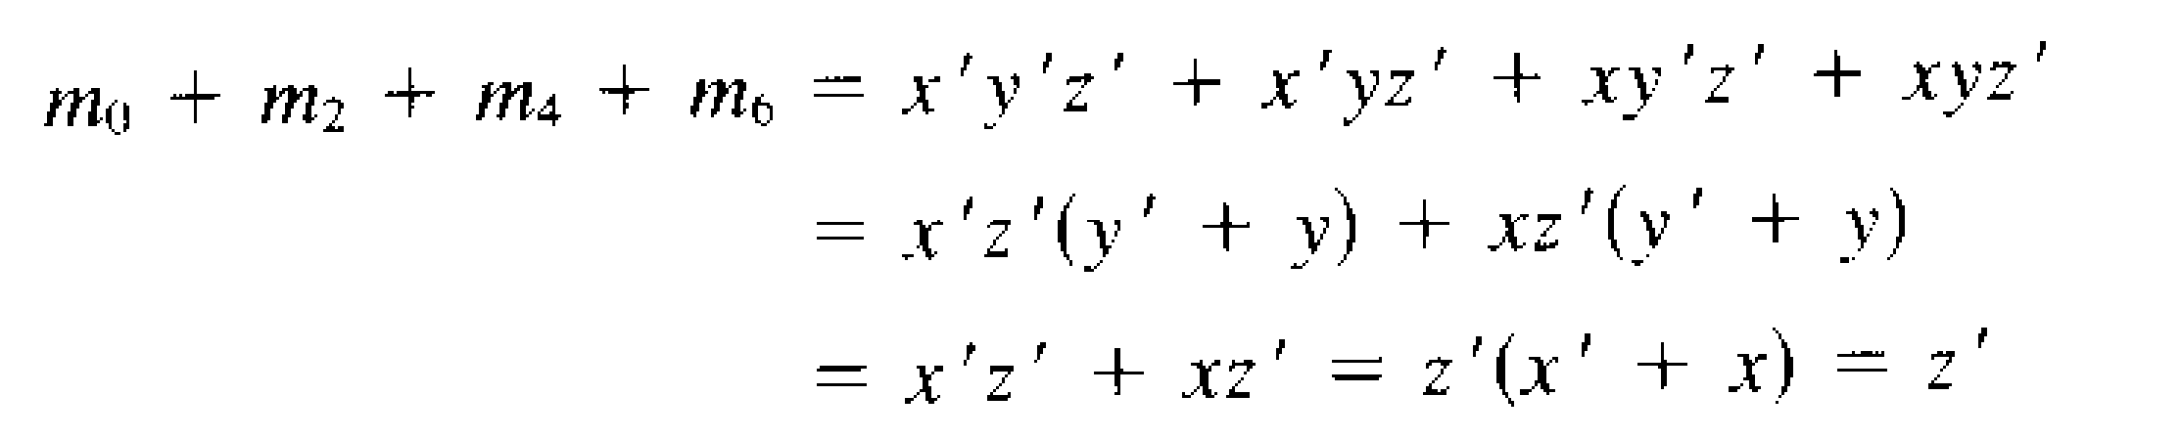
If F=∑(0,2,4,6), then simplify it
000
010
100
110
1
1
=Z’
1
1

Slide 12
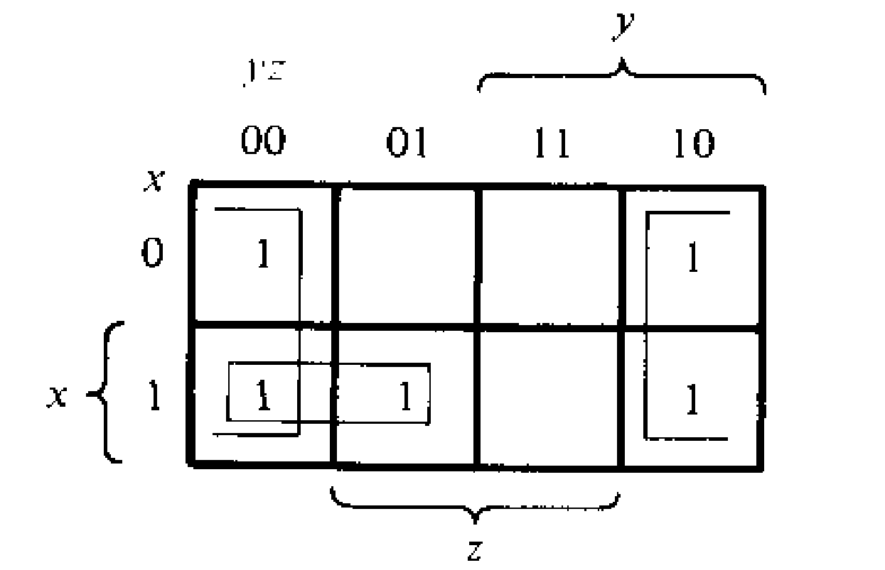
Try it yourself
F=∑(0,2,4,5,6), Simplify it.
Solution
F= xy’ + z’

Slide 13
Try it yourself:
F=A’C+A’B+AB’C+BC
a) Express it as SOP (i.e. ∑)
b) Simplify it using Kmap

Slide 14
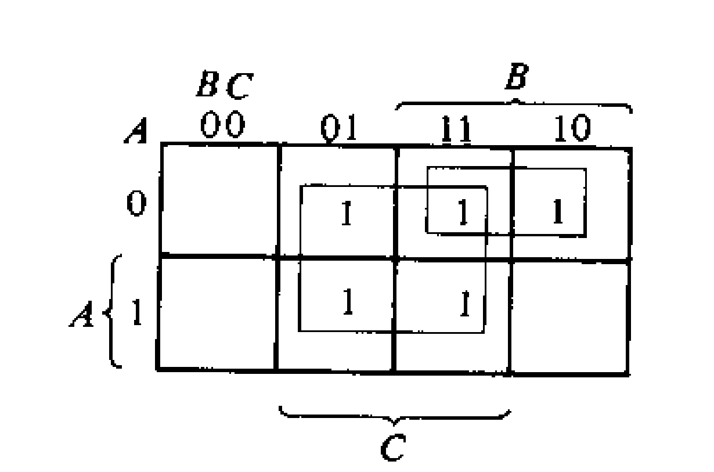
Solution
(a) F= ∑(1,2,3,5,7)
(b)F=C + A’B
To find A’C, coincide A’ (first row) with C( middle 2 column)
To find A’B, coincide A’ (first row) with B( last 2 column)
To find BC, coincide B (last 2 column) with C( middle 2 column)
To find AB’C, is m5( 2nd row 2nd column)

Slide 15
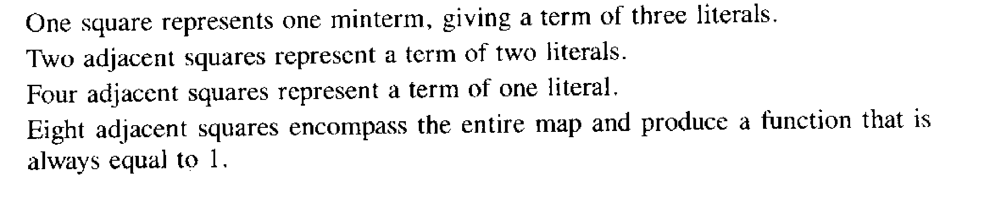
Summary of grouping in 3-variable map

Slide 16
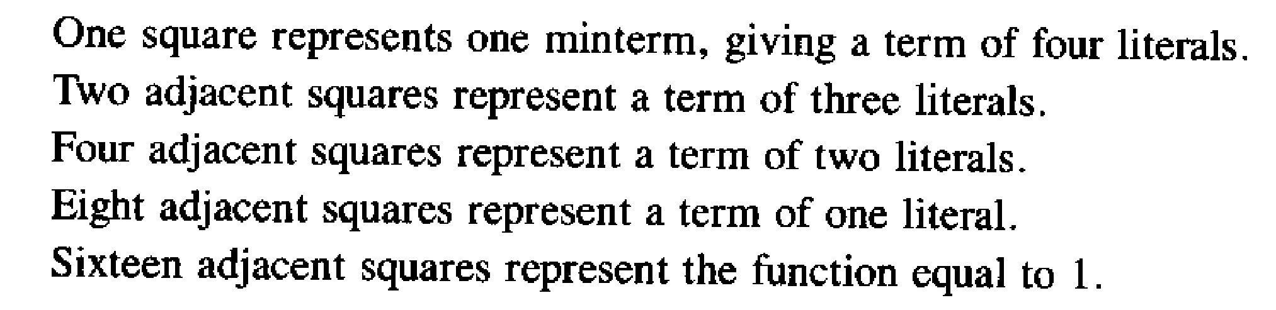
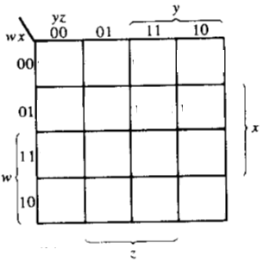
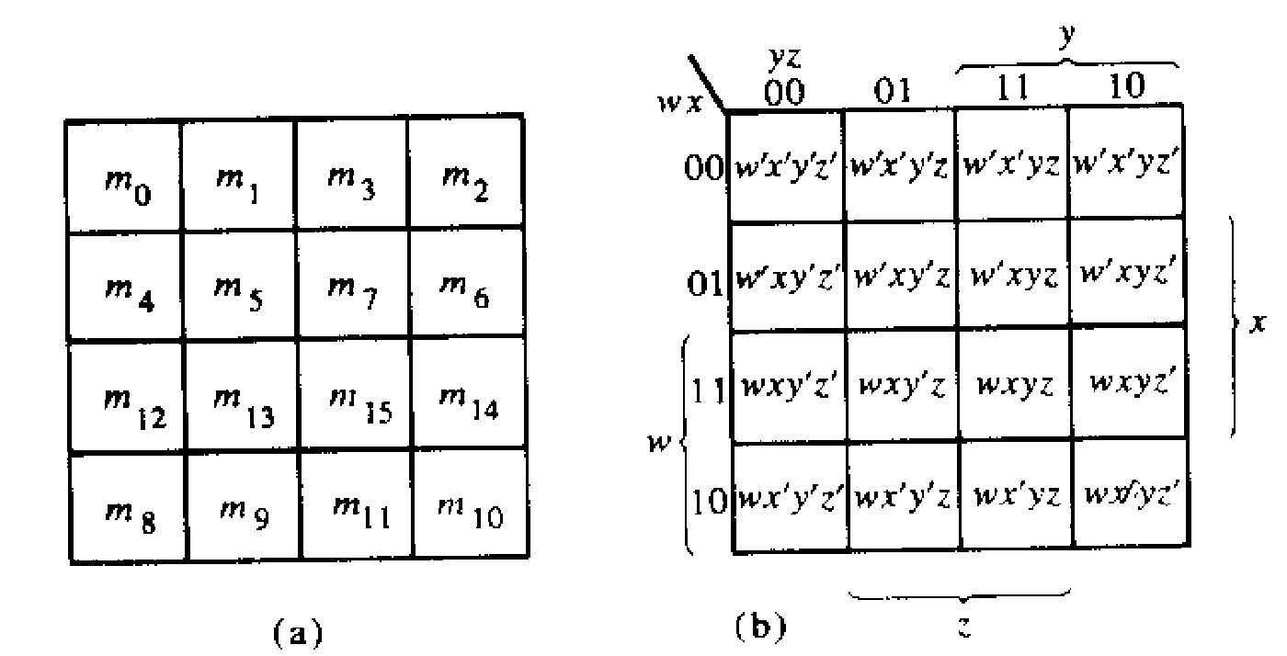
Four variable map
Adjacent squares can be side by side or lie in 4 corner or top-bottom or left-right edge condition. Example, m0 -m2 are adjacent and similarly m3-m11 are adjacent
0000
0001
0011
0010
0100
0101
0111
0110
1100
1101
1111
1110
1000
1001
1011
1010

Slide 17
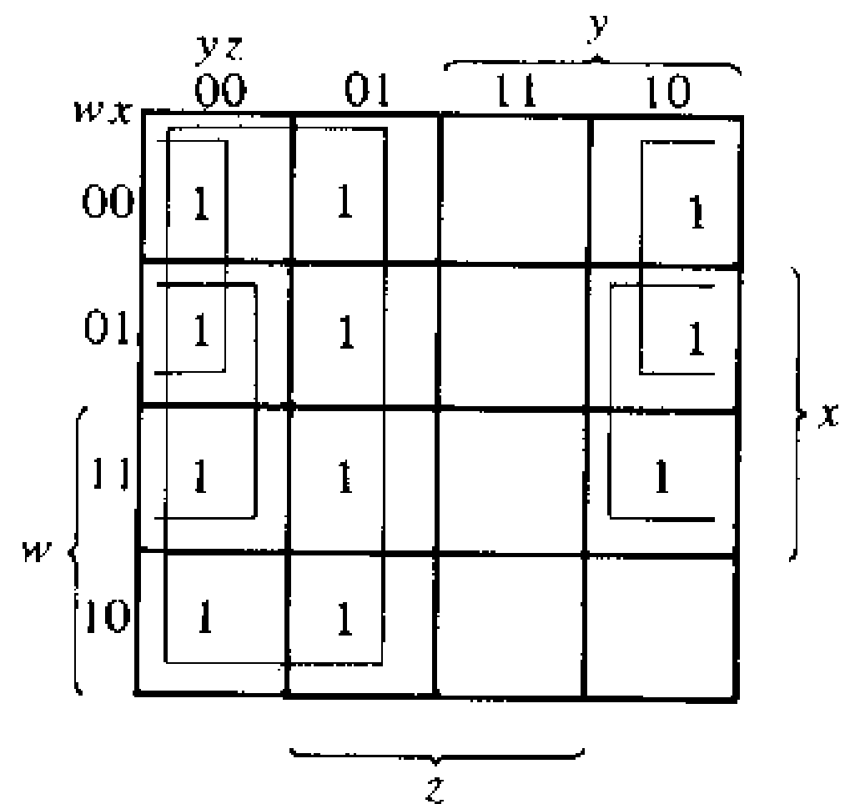
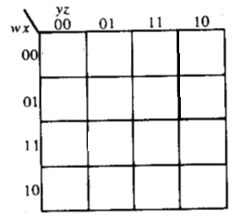
Simplify F=∑(0,1,2,4,5,6,8,9,12,13,14)
Note: it is allowed to use the same ‘1’ more than once.
1
1
1
1
1
1
1
1
1
1
1
F= xz’+ y’+ w’z’

Slide 18
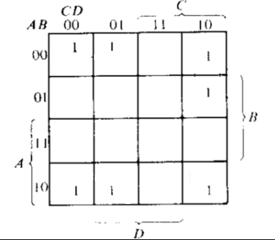
Try it yourself
F=A’B’C’+B’CD’+A’BCD’+AB’C’

Slide 19
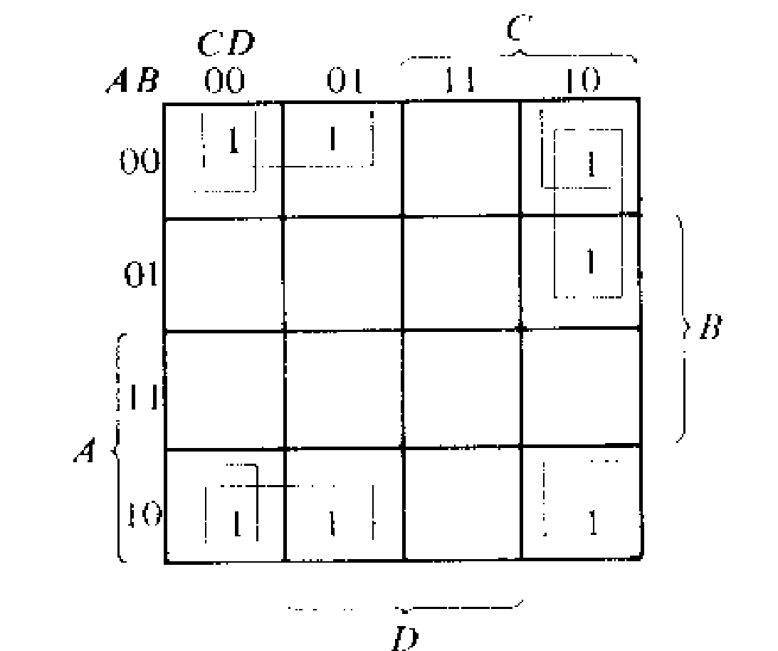
Solution
F=A’B’C’+B’CD’+A’BCD’+AB’C’
F=B’D’+B’C’+A’CD’

Slide 20
Don’t Care condition
Don't cares in a Karnaugh map, or truth table, may be either 1s or 0s, as long as we don't care what the output is for an input condition we never expect to see.
We plot these cells with a special sign, ‘X’, among the normal 1s and 0s.
When forming groups of cells, treat the don't care cell as either a 1 or a 0, or ignore the don't cares. This is helpful if it allows us to form a larger group than would otherwise be possible without the don't cares.
There is no requirement to group all or any of the don't cares. (i.e. do not make any group only consisting the don’t cares). Only use them in a group if it simplifies the logic.

Slide 21
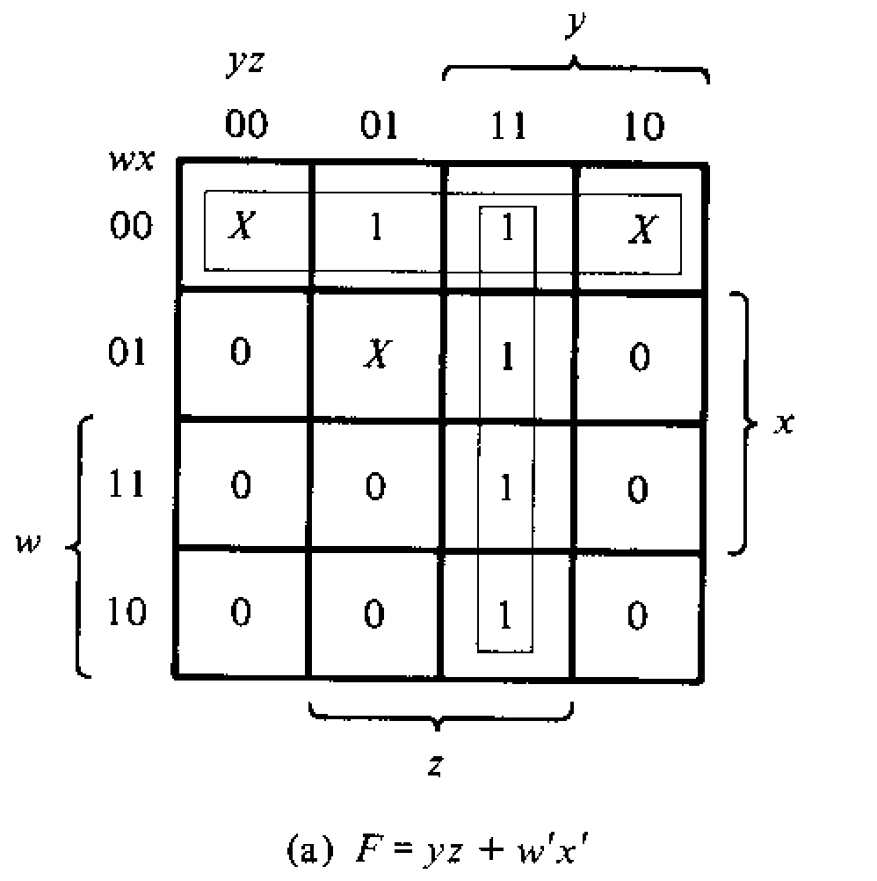
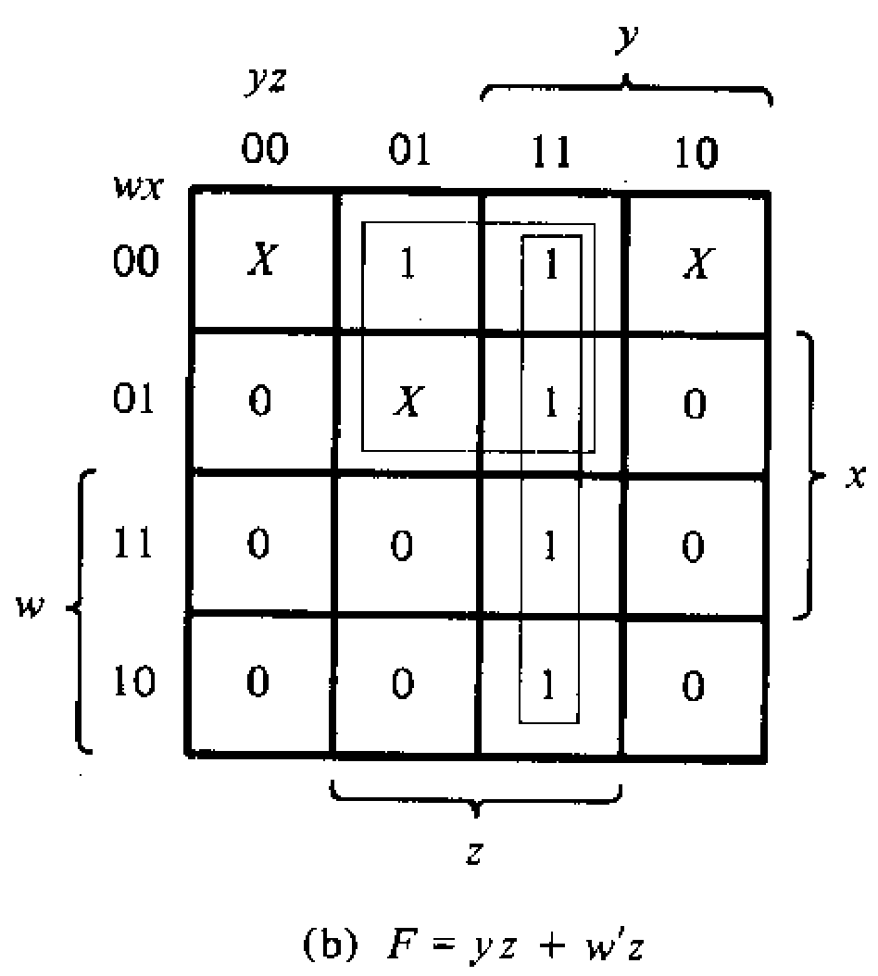
Simplify F(w,x,y,z)= ∑(1,3,7,11,15) and don’t care d(w,x,y,z)= ∑(0,2,5) Solution: Even though 2 solutions are not same, but either 1 is acceptable. Such scenario only applicable for Don’t care scenarios!

Slide 22
APPLICATIONS OF K-MAP

Slide 23
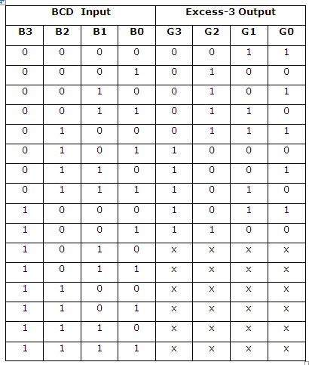
Example 1: Design and draw the circuit diagram of BCD to Excess-3 code converter
W X Y Z
Q1.Treat each W, X, Y and Z as a function and write them as SOP
Q2. Based on the SOP, draw the circuit diagram of BCD to Excess-3 code converter
W X Y Z
Any value higher than 9 will result into don’t care output

Slide 24
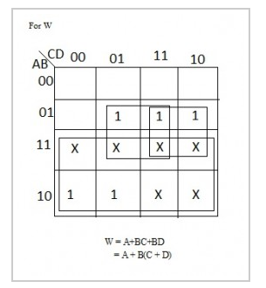
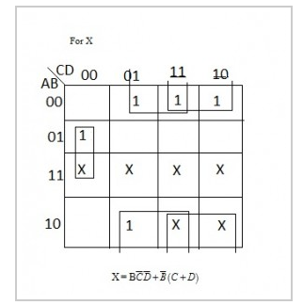
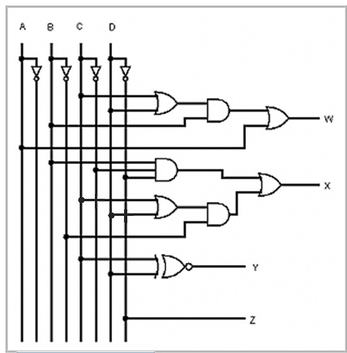
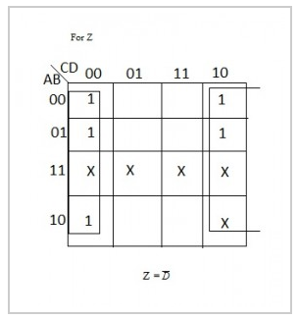
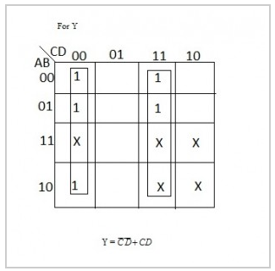

Slide 25
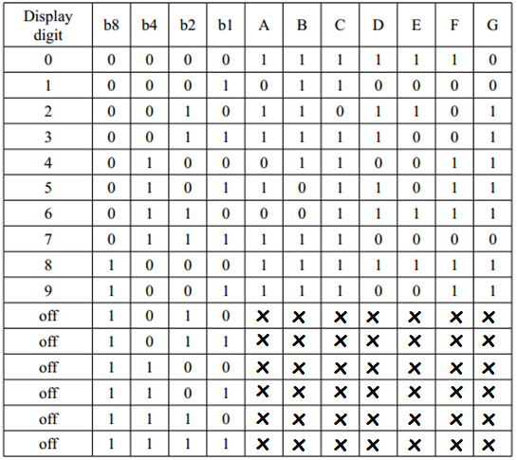
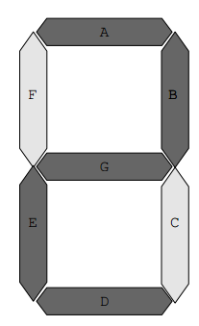
Example 2: 7 segment display board

Slide 26
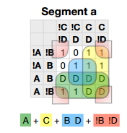
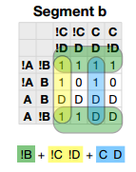
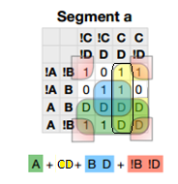
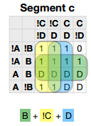
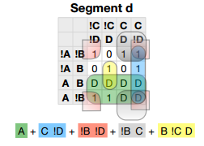
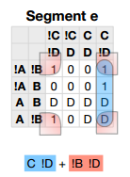
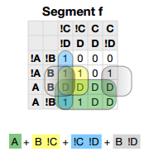
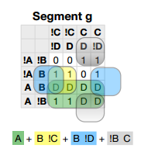

Slide 27
Try it by your self
A car garage has a front door and one window, each of which has a sensor to detect whether it is open. A third sensor detects whether it is dark outside. A security system for the garage follows this rule: the alarm rings if the alarm switch is turned on and either the front door is not closed or it is dark and the side window is not closed.

Slide 28
Solution
SwitchOn | Door | Window | Dark | AlarmRing
0 | 0 | 0 | 0 | 0
0 | 0 | 0 | 1 | 0
0 | 0 | 1 | 0 | 0
0 | 0 | 1 | 1 | 0
0 | 1 | 0 | 0 | 0
0 | 1 | 0 | 1 | 0
0 | 1 | 1 | 0 | 0
0 | 1 | 1 | 1 | 0
1 | 0 | 0 | 0 | 0
1 | 0 | 0 | 1 | 0
1 | 0 | 1 | 0 | 0
1 | 0 | 1 | 1 | 1
1 | 1 | 0 | 0 | 0
1 | 1 | 0 | 1 | 0
1 | 1 | 1 | 0 | 1
1 | 1 | 1 | 1 | 1
WDk
SDr
1
1
1
AlarmRing=SWDk+SDrW
Assuming
AlarmRing = 1 if Alarm rings, 0 otherwise.
Switch On = 1 if alarm switch is on, 0 otherwise.
Door = 1 if door is not closed, 0 otherwise.
Window = 1 if window is not closed.
Dark = 1 if it is dark outside, 0 otherwise.

Slide 29
Solution
WDk
SDr
SwitchOn | Door | Window | Dark | AlarmRing
0 | 0 | 0 | 0 | 0
0 | 0 | 0 | 1 | 0
0 | 0 | 1 | 0 | 0
0 | 0 | 1 | 1 | 0
0 | 1 | 0 | 0 | 0
0 | 1 | 0 | 1 | 0
0 | 1 | 1 | 0 | 0
0 | 1 | 1 | 1 | 0
1 | 0 | 0 | 0 | 0
1 | 0 | 0 | 1 | 0
1 | 0 | 1 | 0 | 0
1 | 0 | 1 | 1 | 1
1 | 1 | 0 | 0 | 0
1 | 1 | 0 | 1 | 0
1 | 1 | 1 | 0 | 1
1 | 1 | 1 | 1 | 1
1
1
1
AlarmRing=SWDk+SDrW
Next Step
You do have to draw the circuit for the above function
You may be asked to draw the circuit using basic gates or universal gates
By now, you should be able to do it yourself. So please try.

